Slide 1
Metric Analysis Framework Peter Yoachim University of Washington

Slide 2
Goals
Given a list of observations (times, filters, seeing, skybrightness, etc.), quantify how well you can do your science
For today:
Introduction to OpSim and MAF
Work through running MAF with iPython notebooks

Slide 3
LSST Ecosystem
Data Management (aka DM): Take a bunch of raw images and process them to make catalogs
Sims:
Photon Simulator (aka PhoSim): Simulate LSST images by tracing photons
Catalog Simulator (aka CatSim): A realistic catalog of objects LSST could observe (Stars, galaxies, etc)
Calibration Simulation (aka CalSim): Uber-cal for LSST
Operations Simulator (aka OpSim): Simulate the operations of the telescope (motion of the motors) as well as the scheduling of observations.
Metric Analysis Framework (MAF): Analyze and visualize how well an astronomical survey performs.
The (LSST) Stack

Slide 4
We can’t do it all
While we have all the tools to simulate LSST end-to-end, that’s pretty computationally expensive
We hope we can approximate a few of those components when doing the scheduling strategy optimization
Rather than use a catalog of objects, assume a simple distribution of sources (e.g., a uniform grid of galaxies)
Rather than use PhoSim+DM, just assume Gaussian noise or simple centroiding errors
CatSim + OpSim -> PhoSim -> DM => source catalog
Opsim + MAF -> what fraction of my galaxies are “well observed”

Slide 5
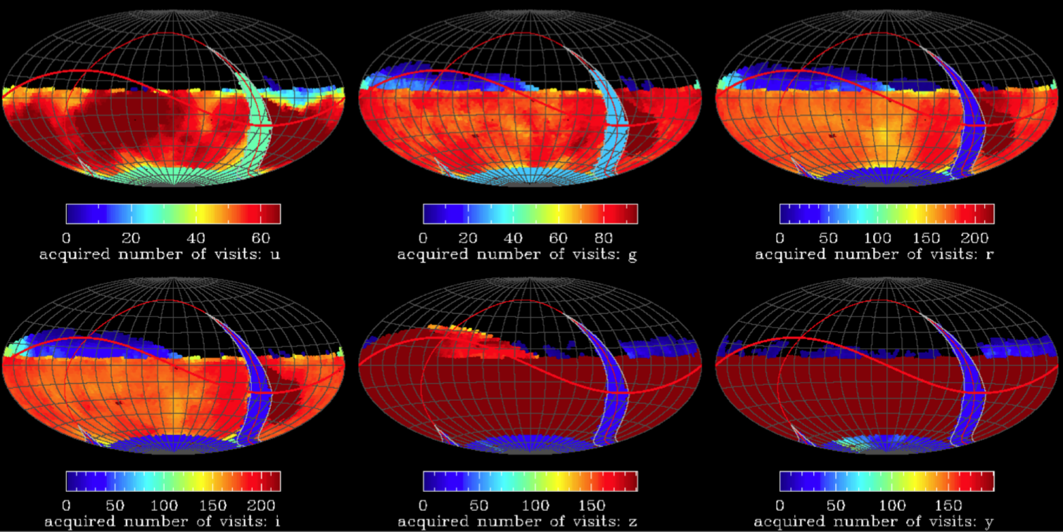
Operations simulations
Constraints are provided by the astrophysical properties of the site (e.g. sky background), engineering models (settle time) and science requirements
Operations simulator generates sequences of LSST observations together with their properties (seeing, sky brightness, depth, filter). About 2.5 million visits over 10 years
Metrics Analysis Framework calculates statistics about these simulated surveys and relates them to specific science questions (through metrics)

Slide 6
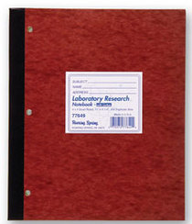
Classical Astronomy
You go to a telescope and take some data
Did you get enough data to do your science?
Flip through the log book and check

Slide 7
LSST Era Astronomy
Over 10 years, LSST will make around 2.5 million visits
Need a tool to analyze ~300 log books

Slide 8
MAF Goals
The goal of the Metric Analysis Framework is to provide an easy way to visualize the properties of a survey and quantify the science that can be done with that survey
Able to run in an automated fashion so we can compare large numbers of simulated surveys
Easily extended so users can contribute their own analysis—we want YOU to show us the best way to measure a survey’s performance

Slide 9
The Operations Simulator
OpSim is our source for what these 2.5 million visits might look like.
Includes real weather log
Scheduled and unscheduled down time
A scheduler that balances several science goals
OpSim scheduler based on “Proposals”
Wide-Fast-Deep (aka, “the main survey”): Cover ~20,000 sq deg
North Ecliptic Spur: Solar system objects
Deep Drilling Fields: ~6 deep fields
Galactic Plane
South Celestial Pole

Slide 10
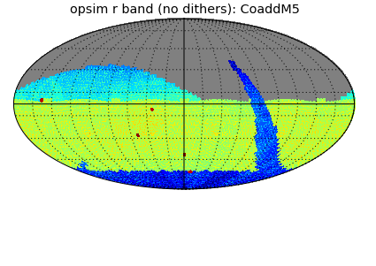
The Proposals
NES
GP
WFD
SCP
DD

Slide 11
Opsim Output
An OpSim database (distributed to the community as sqlite files) contains multiple tables that record the observations taken, state of the telescope, configuration of the scheduler, etc.
For our interests, we will focus on the Summary table in each OpSim run database. This is your very detailed observing log book.

Slide 12
What’s in OpSim Output
For each visit, Opsim records
RA,Dec
Filter
MJD
Night
visitTime
Seeing
Airmass
Skybightness
Rotation angle of the camera
LST
Alt,Az
Distance to moon
Distance to Sun
Moon position
Moon phase
5-sigma depth (so can calc SNR of an object)
Dithered RA,Dec
And more…
More documentation on OpSim
Summary table here:
http://ls.st/5d8

Slide 13
OpSim Warnings
OpSim records LSST “visits”
1 visit = 2 back-to-back exposures!
By default, OpSim uses fixed fields and does not dither
There can be “repeated” entries in the Summary table if a visit is used for multiple proposals (e.g., a visit can count towards WFD and Deep Drilling).
In MAF, we take care of this by doing a SQL “group by” on the expMJD.
Observation for | Object | MJD | RA | DEC
Jen | M31 | 3456.4 | 0:42:44 | 41:16:09
Jen | Feige 34 | 3456.8 | 10:39:37 | 43:06:09
Dave | Feige 34 | 3456.8 | 10:39:37 | 43:06:09
Dave | M1 | 3457.1 | 05:34:32 | 22:00:52
Not unique

Slide 14
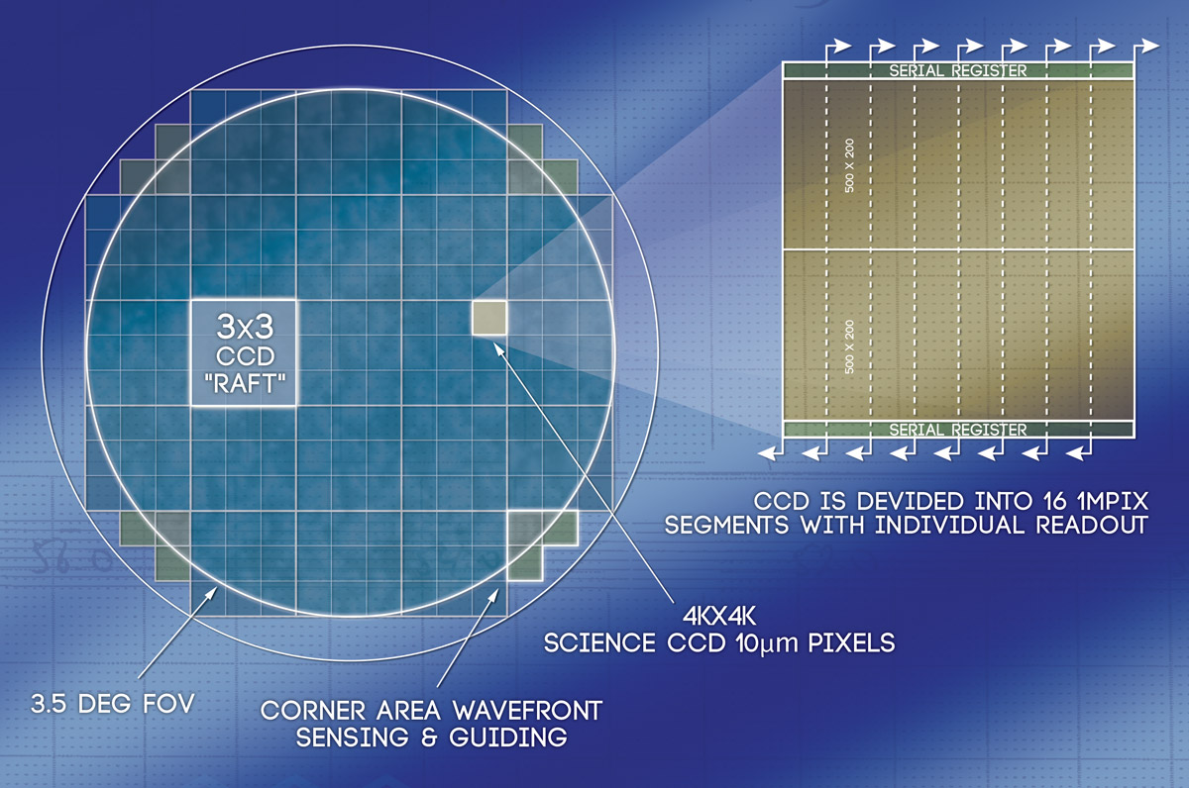
MAF Warnings
By default, we assume if an object is within 1.75 degrees of the center, it gets observed.
This is probably a few % optimistic given chip gaps, etc.
You can run with the full focal-plane geometry, but it slows things down a bit.

Slide 15
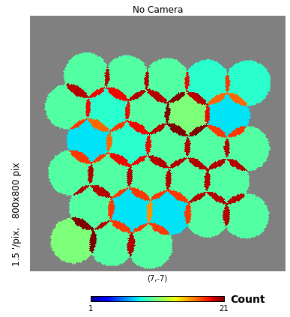
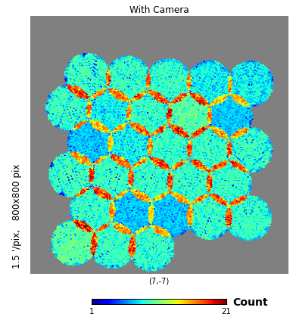
With and Without Chip Gaps

Slide 16
How do we quantify how well a survey performs?
Some things we commonly ask
What’s the median seeing of all the visits?
How many exposures do we get per night?
What’s the co-added depth of a deep drilling field?
What’s the average co-added depth at the end of the survey?

Slide 17
To answer these we have to divide the observations up
Some things we commonly ask
What’s the median seeing of all the visits? All the observations
How many exposures do we get per night? Observations per night
What’s the co-added depth of a deep drilling field? Observations at a point in the sky
What’s the average co-added depth at the end of the survey? Observations at many points in the sky
In MAF, splitting the visit up correctly is done by “slicers”

Slide 18
To answer these we have to compute some algorithm
Some things we commonly ask
What’s the median seeing of all the visits?
How many exposures do we get per night?
What’s the co-added depth of a deep drilling field?
What’s the average co-added depth at the end of the survey?
In MAF, computing algorithms is done by “metrics”
To answer these questions with MAF, you take observations from a database and then pair a slicer and a metric.

Slide 19
The Three Primary Slicers
UniSlicer
Passes all data directly to the metric algorithm.
How to answer, “what’s the mean seeing?”, “What is median airmass?”, etc.
OneDSlicer
Slice data based on one parameter.
How to answer, “what’s the distribution of exposures per night?”, “What’s the distribution of slew times?”
HealpixSlicer
Loops over points on the sky and returns overlapping exposures
How to get a map of the sky. Calculate co-added depths.

Slide 20
General MAF Outline
Survey DB
SQL query
Slicer
Slice the data (e.g, find observations that overlap a set of points on the sky)
Metric
Compute an algorithm on each slice
Outputs (plots)
Pdf/png and numpy save files

Slide 21
Example slicer + metric combinations
Survey DB
Where filter=‘r’
What is the average seeing in r?
Slicer
UniSlicer (pass all the data through to the metric)
Metric
Mean of Seeing
Outputs (plots)
Pdf/png and numpy saves
0.65 arcsec

Slide 22
Example slicer + metric combinations
What is the distribution of slew times?
Survey DB
All data
Slicer
OneDSlicer
Slice by slewtime with 10s bins
Metric
Count
Outputs (plots)
Pdf/png and numpy saves

Slide 23
Example slicer + metric combinations
How many visits per night?
Survey DB
All data
Slicer
OneDSlicer
Slice by night
Metric
Number of visits
Outputs (plots)
Seasonal oscillation and nights with weather and engineering downtime
Pdf/png and numpy saves

Slide 24
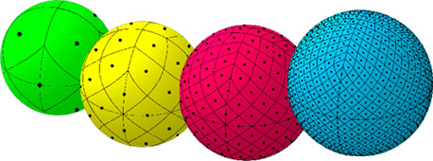
HEALpixels
For our spatial binning, we use HEALpixels
Equal area pixels
Popular with cosmologists, rapidly compute power spectra
Or, use a custom list of RA,Dec points
Can also bin by OpSim field ID. Faster, but field overlaps are not resolved

Slide 25
MAF Examples
What is the coadded depth across the sky in g band?
Survey DB
Filter = ‘g’
Slicer
HealpixSlicer
Metric
Coadded depth
Given single visit depths
Outputs (plots)

Slide 27
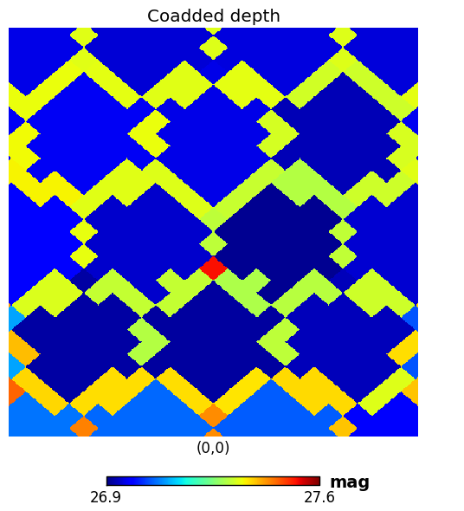
nside=128, 27.5 arcim resolution

Slide 28
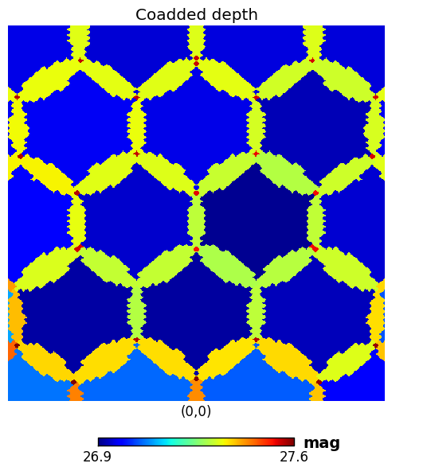
Nside=512, 6.9 arcmin resolution

Slide 29
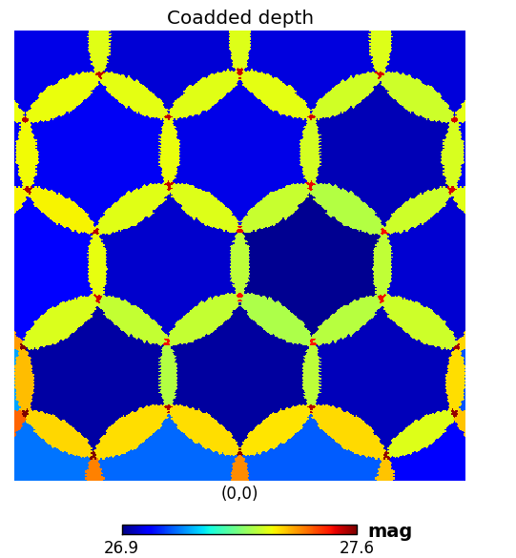
Nside=1024, 3.4 arcmin resolution

Slide 30
MAF Examples
Survey DB
Filter = ‘g’
Slicer
HealpixSlicer
Coadded depth
Given single visit depths
Metric
Outputs (plots)

Slide 31
Healpixels let us compute Power Spectra
Peak at l=140 (~1 degree), caused by field overlaps
Peak at l=270 from triple overlaps.

Slide 32
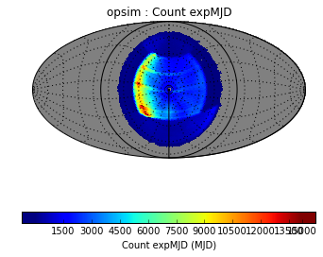
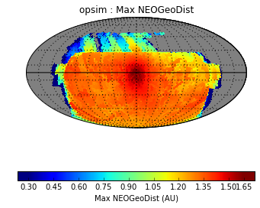
Healpix beyond RA,Dec
The HealpixSlicer defaults to RA,Dec, but can be set to use Alt,Az or ecliptic coordinates.

Slide 33
Does it go in the SQL or the Slicer?
Survey DB
SQL query
The slicer determines the type of output plot. We tend not to plot things as a function of filter or proposal ID, so those are set with the SQL where-clause
Sometimes we use SQL for time, e.g., if we want to look at the first year performance of the survey. Other times the slicer will slice on time.
Slicer
Slice the data (e.g, find observations that overlap a set of points on the sky)
Metric
Compute an algorithm on each slice
Outputs (plots)
Pdf/png and numpy save files

Slide 34
Recap: slicer + metric
Which slicer you pick will determine your output plots
Three main slicers
UniSlicer: Pass all the data, returns a number
OneDSlicer: Slice by one variable (like per night), returns a single plot (like histogram)
HealpixSlicer: Slice on observations overlapping healpixels, return a skymap, histogram, and powerspectum
Many metrics to pick from
coaddm5
Max
Mean
Median
Min
FullRange
Rms
Sum
RobustRMS
Binary
FracAbove
FracBelow
OpenShutter
Completeness
Parallax
ProperMotion
Fft
Supernova
Uniformity
TemplateExists
VisitGroups

Slide 35
Additional Capabilities
Summary Statistics
Stackers: Adding derived columns

Slide 36
Summary Stats on a HealpixSlicer
Survey DB
Filter = ‘g’
Slicer
HealpixSlicer
Coadded depth
Given single visit depths
Metric
Outputs (plots)
e.g.,
Mean and RMS of metric values
Compute a metric on your results
Summary stats

Slide 37
Add a psudo-column
Survey DB
SQL query
Sometimes it’s convenient to calculate a new column that isn’t present in Opsim before slicing the data.
For example, normalized airmass, parallax factor, dither offset, hour angle.
We have “stackers” that allow you to stack new columns onto the SQL results before they are passed to the slicer. (we’re calling them stackers since we are using the numpy stack functions to add columns to numpy arrays)
Stacker
Add column
Slicer
Metric
Outputs (plots)

Slide 38
Slicer + metric summary
UniSlicer + metric = single number (mean seeing)
OneDSlicer + metric = histogram (or something per night)
HealpixSlicer + metric = skyplot, histogram, power spectra
As we’ll see in the code, to run MAF you define a “metricBundle” that has a metric, slicer, and sql constriant (and optionally stackers, summary stats, plot kwargs).

Slide 39
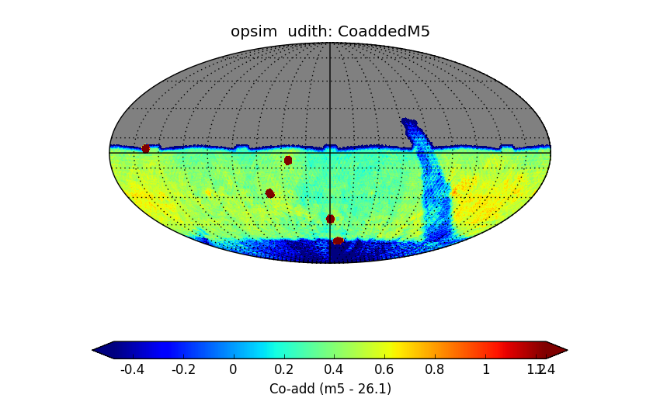
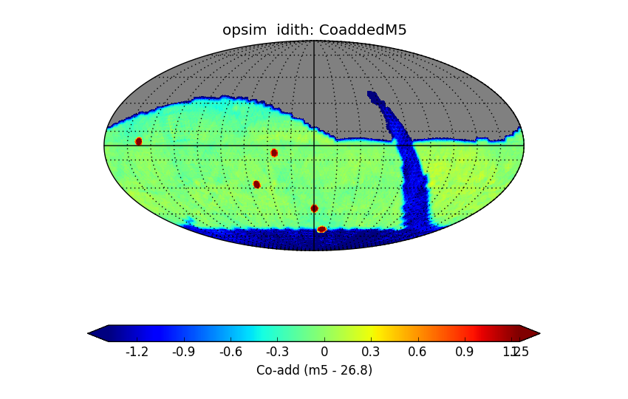
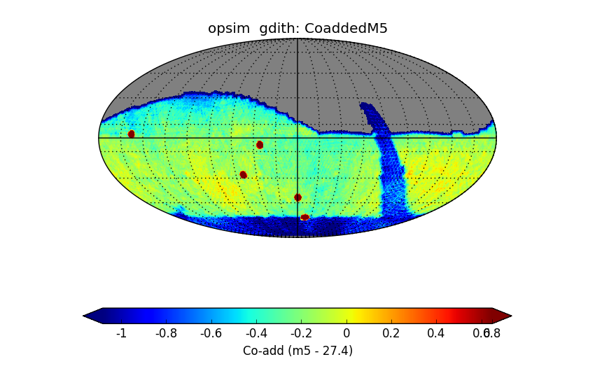
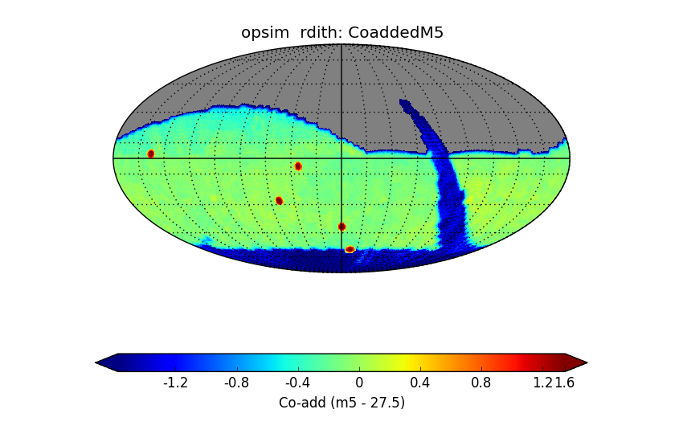
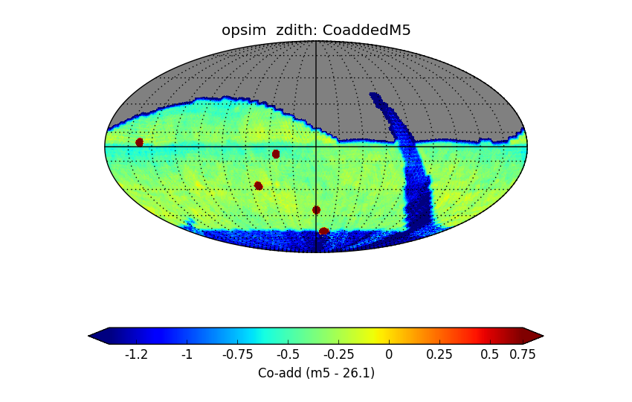
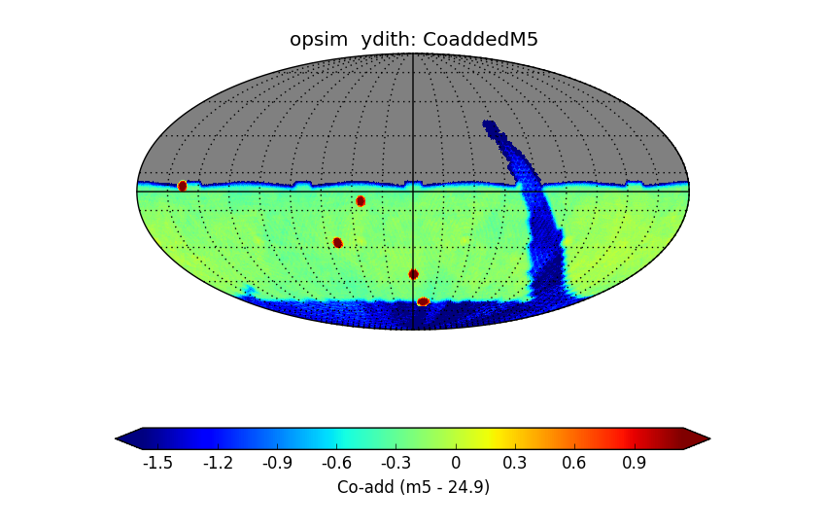
Example MAF Output
Can create large reports with MAF
Number of Visits, coadded depth, median single-visit depth, median airmass, median seeing
Per filter, Per proposal ID
u
g
r
i
z
y

Slide 40
One way to think about the Healpix grid
Which observations overlap star/galaxy/healpixel #1?
Pass those to the metric algorithm and save the result
Which observations overlap star/galaxy/healpixel #2?
Pass those to the metric algorithm and save the result.

Slide 41
Parallax Example Metric
For each observation, compute the parallax factor of the observation (with a stacker)
At each healpixel, assume there is a mag=20 star with 1” parallax
Use the 5-sigma depth and seeing to compute the expected centroid uncertainty

Slide 42
How well can we measure X given a sequence of observations?
Given the list of observations (dates, filters, seeing, etc.) of your favorite type of object, can we quantify how well we can do a science?
Given those observations:
X% of z=1.5 supernova would be discovered
The proper motion fit for a star would have a precision of X milliarcseconds
The shape of a galaxy could be recovered to X%
We could get follow-up spectra on X of the observations
We need the algorithms to convert an observation list into a science result.

Slide 43
Metrics we have developed already
Proper Motion and Parallax fit uncertainties
Transient light curve detection and characterization
Period fitting
NEO detection distance
All of these can be sub-classed and extended to write your own metrics, you don’t have to start from scratch!

Slide 44
MAF vocab
OpSim: The Operations Simulator that outputs a database of simulated observations
Slicer: The part of MAF that slices data correctly to make histograms, sky maps, etc.
Metric: The algorithm that is computed on each slice from the slicer
Stacker: Adds a psudo-column to the OpSim
Healpixel: A single pixel on an equal area tessellation of the sky.
Summary Statistic: A metric that gets computed on the results of all the slice points (e.g., a mean-of-means across the sky).

Slide 45
Conclusions
The essence of MAF
Select a set of OpSim observations using a SQL query
Use a slicer + metric to analyze the resulting set of observations

Slide 47
Example iPython Notebooks
Github repo: http://ls.st/nm3
Introductory Notebooks
IntroductionNotebook.v3.ipynb: Our introductory notebook, including installation instructions.
Slicers.v3.ipynb: Shows how the same metric can be run with three different slicers to produce different outputs.
TestNotebook.v3.ipynb: Test that ipython is working and you can load the MAF modules.
Advanced Capabilities
Stackers.v3.ipynb: Example of calculating and adding a new column to the OpSim output "on-the-fly" with MAF. Here, we calculate the hour angle of each pointing and then look at the distribution.
WritingNewMetric.v3.ipynb: A guide on how you can write and add your own algorithm into MAF by sub-classing an existing metric.
UsingMetricBundleData.v3.ipynb: Example of saving/restoring analysis and then adjusting and combining plots.
Static Science Notebooks
DepthGoodSeeing.v3.ipynb: Using SQL constraints to compare coadded depth and coadded depth of only visits taken under good seeing conditions.
DepthPerYear.v3.ipynb: An example of using SQL constraints to see the evolution of the coadded depth through the survey.
Dithers.v3.ipynb: MAF includes several potential dithering schemes. This notebook demonstrates those dither patterns and compares their effect on the resulting power spectrum.
NVisitsCoadd_AllFilters_DitherComparison.v3.ipynb: Examines the number of visits in each filter as well as comparing dithered and undithered surveys.
Solar System and Astrometry Notebooks
AstrometryMetrics.v3.ipynb: Example of running our proper motion and parallax metrics.
Transient Notebooks
TransientMetric.v3.ipynb: Example of our transient metric where you can set a simple transient light-curve shape and set a variety of detection criteria to measure the fraction of such transients LSST can recover.
Variable Notebooks
Our variable metrics are in the sims_maf_contrib repo. A notebook example of them can be found here.

Slide 48
Clone and Launch Notebooks
1st time only
> git clone git@github.com:lsst-sims/sims_maf_notebooks.git
> cd sims_maf_notebooks/notebooks
> ln –s <path to OpSim database enigma_1189_sqlite.db> . #or cp
Every time
> source loadLSST.bash #setup the LSST stack
> setup sims_maf –t sims #setup MAF
> ipython notebook #Launch ipython

Slide 50
Cadence Metrics
We have developed a number of metrics to help optimize the scheduler for time-domain science.
Early good seeing
Parallax and proper motion
Supernova
AGN
Solar System
Temporal uniformity
We want MOAR!!
Quantify your science for us

Slide 54
What if my metric returns multiple values?
Survey DB
Filter = ‘g’
BestSeeingCoaddMetric:
This metric takes half of the observations with the best seeing and returns the resulting mean seeing and coadded depth.
So now at each Healpixel, we have 2 values, the coadded depth and the mean seeing.
We add “reduce functions” to these metrics that return single values
Slicer
HealpixSlicer
Metric that returns multiple values
Metric
Reduce 1
Reduce 2
Outputs (plots)
Outputs (plots)

Slide 55
Result from 1st reduce function, coadded depth

Slide 56
Result from 2nd reduce function, mean seeing

Slide 57
Make sure you have the latest version
Setup your stack and update to the latest version
>source ~/lsst_home/loadLSST.sh #or similar >eups distrib install sims_maf --t sims
>setup sims_maf --t sims

Slide 58
links
Emails
Peter: yoachim@uw.edu
Lynne: ljones.uw@gmail.com
Conference talks:
https://github.com/LSST-nonproject/XXX

Slide 59
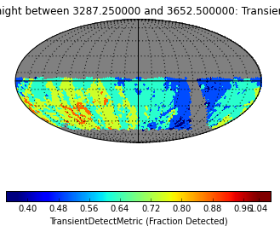
Supernova Metric
Construct a simple saw-tooth light curve
At each healpixel, have a z=0.5 SN blow up every 45 days.
Determine what fraction of them are detected in any filter

Slide 60
MAF
Basic info about MAF
A framework for finding out how well an executed survey meets your science needs.
All Python, part of the LSST stack
Install instructions here: https://confluence.lsstcorp.org/display/SIM/Catalogs+and+MAF
General problem of data analysis and dimensionality reduction
2.5 million observations → data cube → sky map → single number

Slide 61

A better name?
Survey Performance Analysis Tool
SPAT

